Slide 1

Task 1-Seminar 3
The EUxPancreas Cohort Study

Slide 2
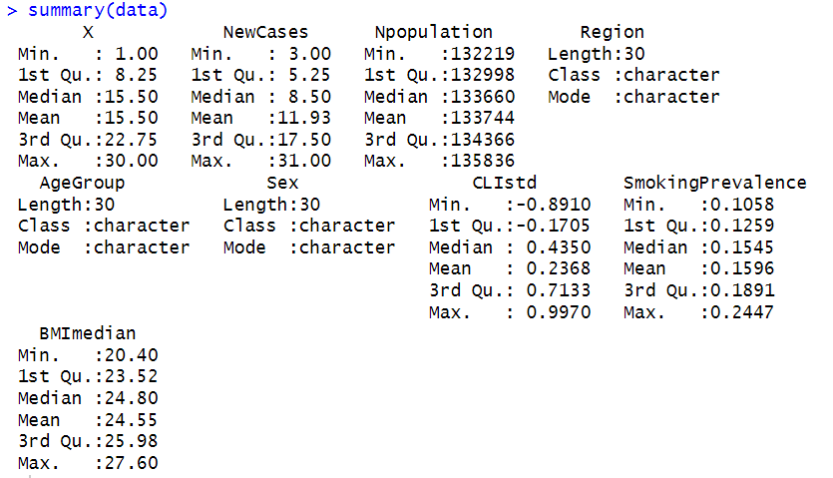
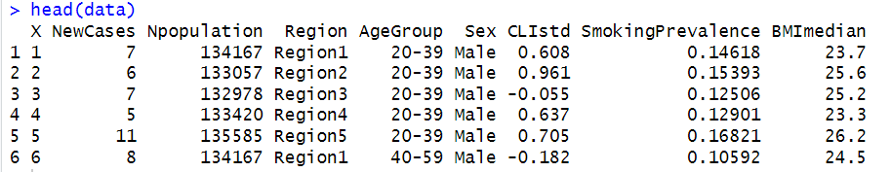
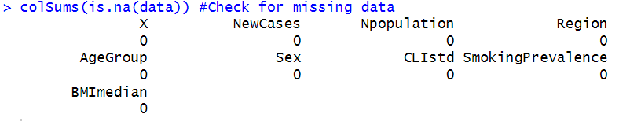
Explore the dataset:
The dataset contained 30 observations across 8 variables with no missing data.

Slide 3
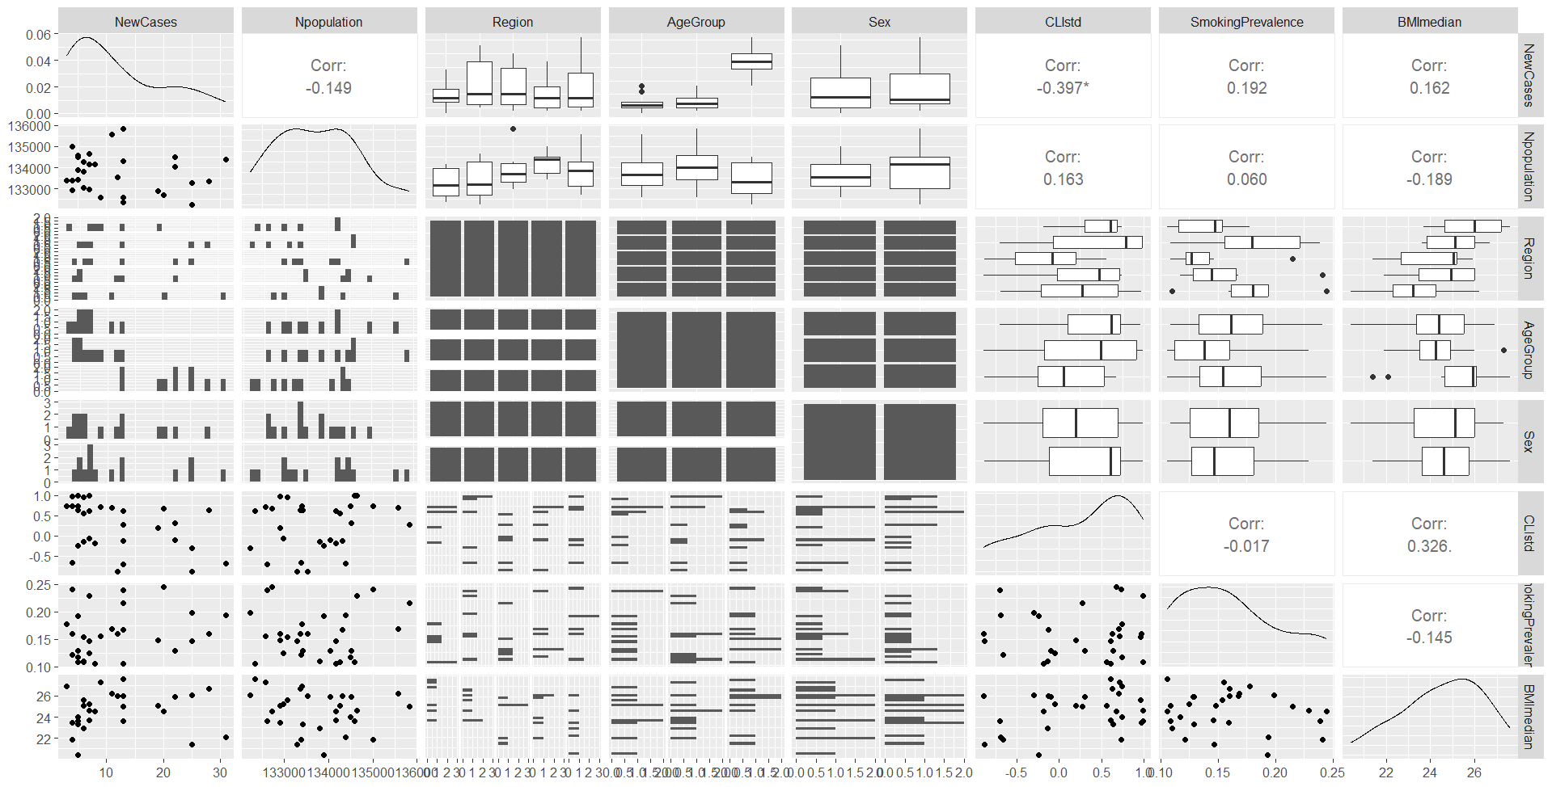
Explore the dataset:
nonnumerical values

Slide 4
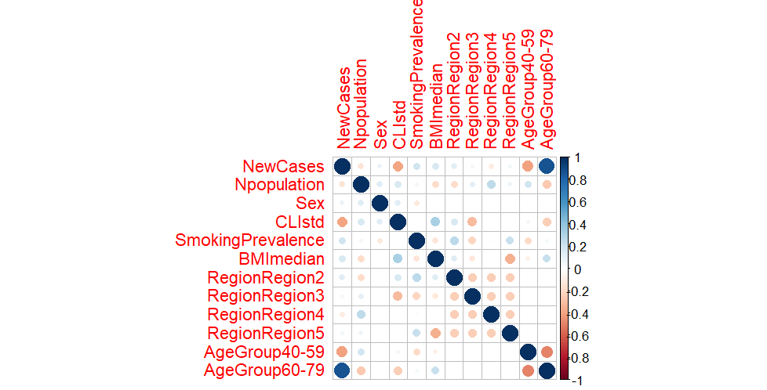
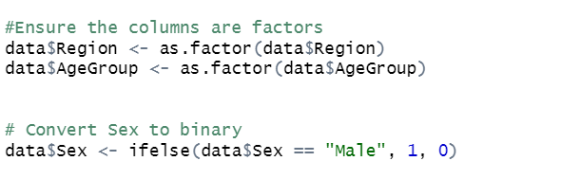
Explore the dataset:
The correlation plot suggests that AgeGroup has a strong positive association with NewCases, while CLIstd (composite lifestyle index) is negatively correlated, suggesting protective effects of healthier lifestyles

Slide 5
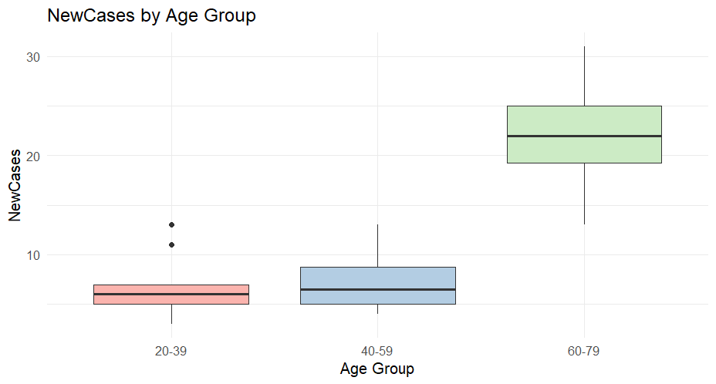
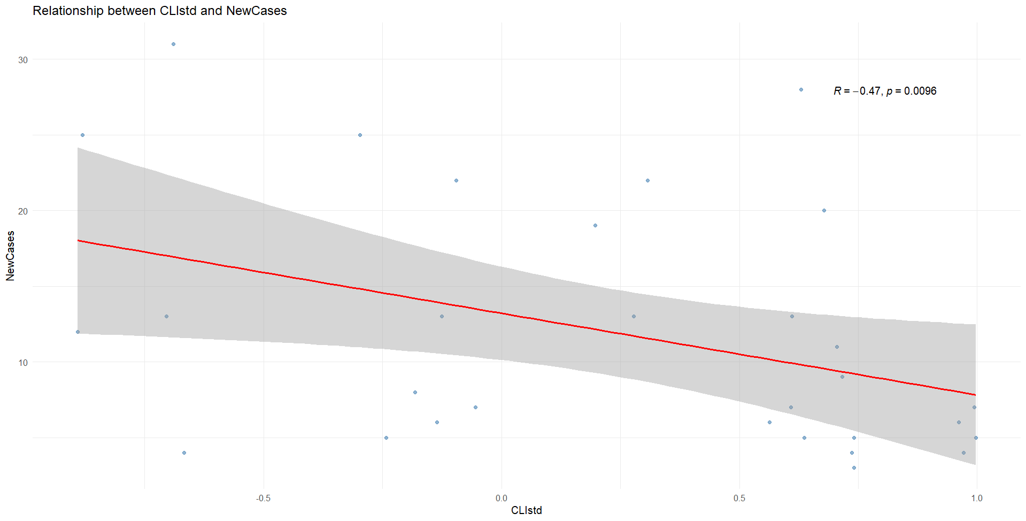
Explore the dataset:

Slide 6
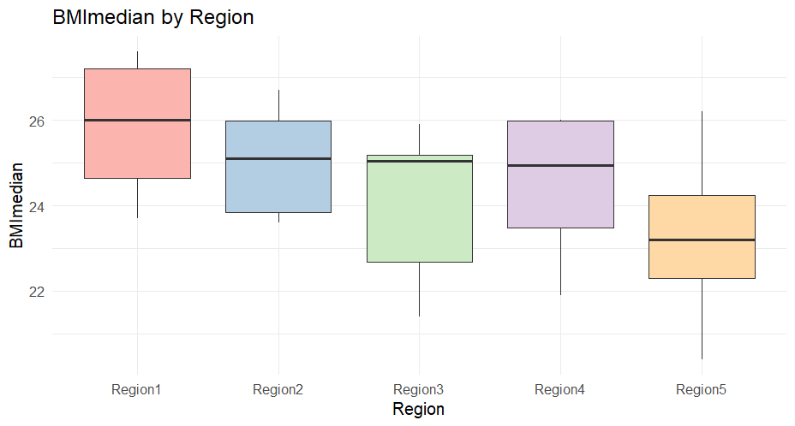
Explore the dataset:

Slide 7
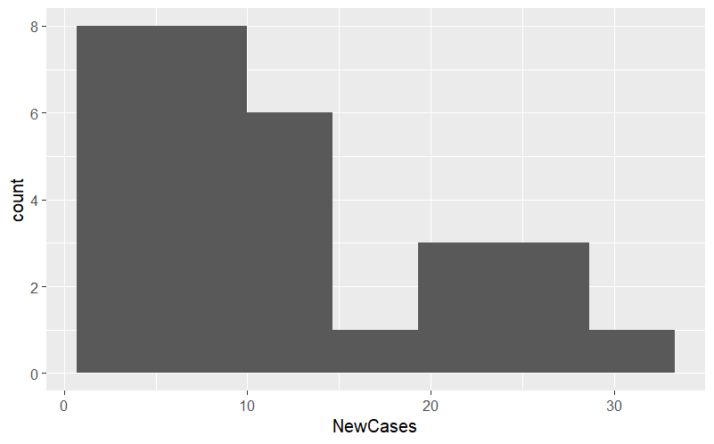
Explore the dataset:
NewCases are right-skewed, supporting Poisson modeling.

Slide 8
Summary of exploration
NewCases follows a count distribution
Higher age groups showed significantly higher incidence rates
Healthier lifestyle scores (CLIstd) were negatively associated with new cases
Regional differences were observed in median BMI

Slide 9

Develop a model to examine the trends in new cases of pancreatic cancer across the recorded population variables and Analyse the model outputs and examine model performance:
Since the outcome variable (NewCases) represents count data and is approximately Poisson-distributed, we used a Poisson GLM with a log link. The population size was included as an offset to account for varying subgroup sizes

Slide 10
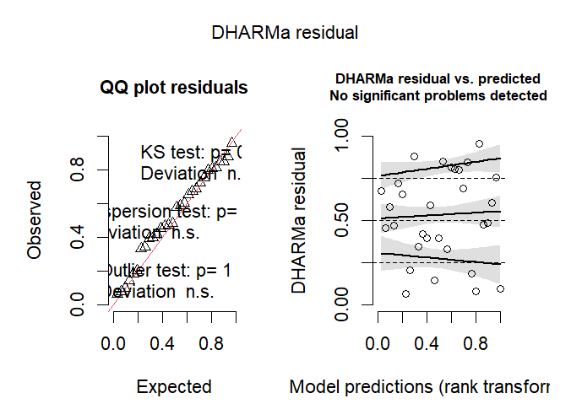
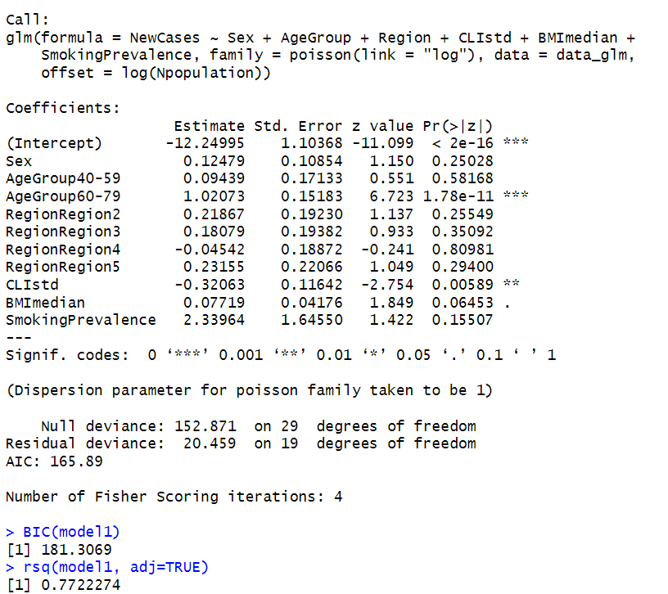
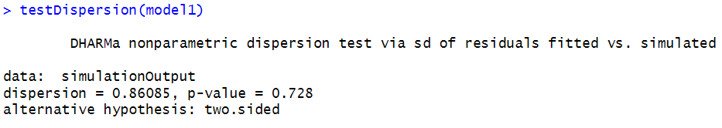
Model 1
All predictors were included. AgeGroup and CLIstd were significant (p < 0.05), while BMI, region and SmokingPrevalence were not
DHARMa residual diagnostics showed no overdispersion and a uniform distribution of simulated residuals, indicating a good model fit.

Slide 11
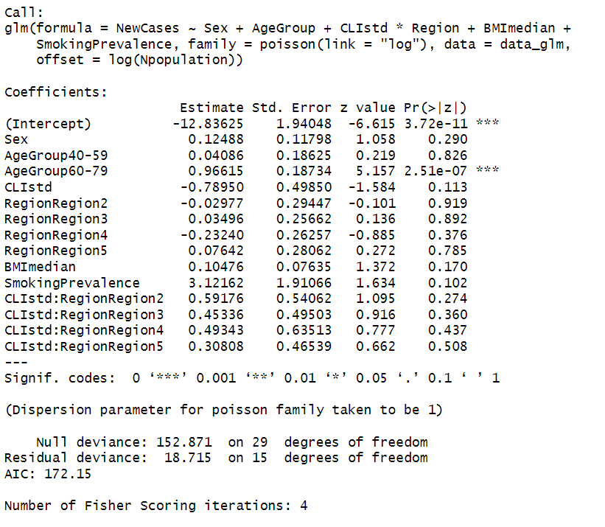
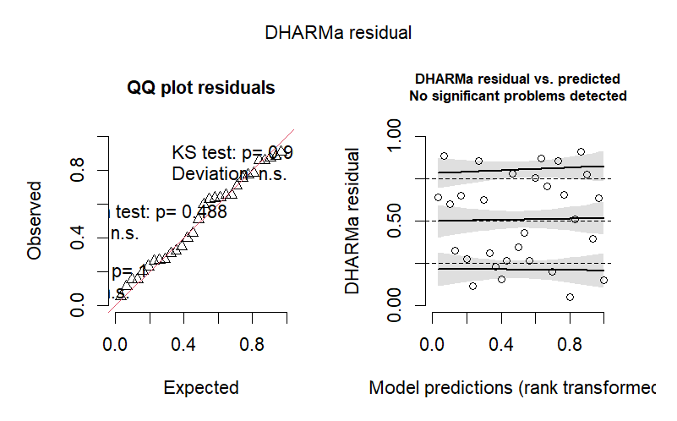
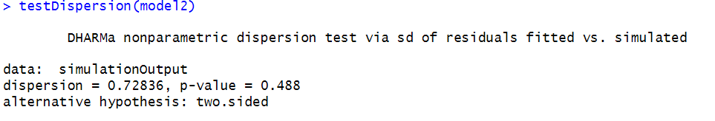
Model 2
Only AgeGroup were significant (p < 0.05), while BMI, sex, region, CLIstd, SmokingPrevalence and the interaction term were not significant. DHARMa residual diagnostics showed no overdispersion and a uniform distribution of simulated residuals, indicating a good model fit.

Slide 12
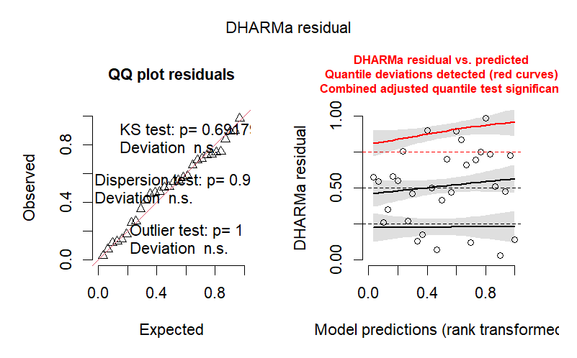
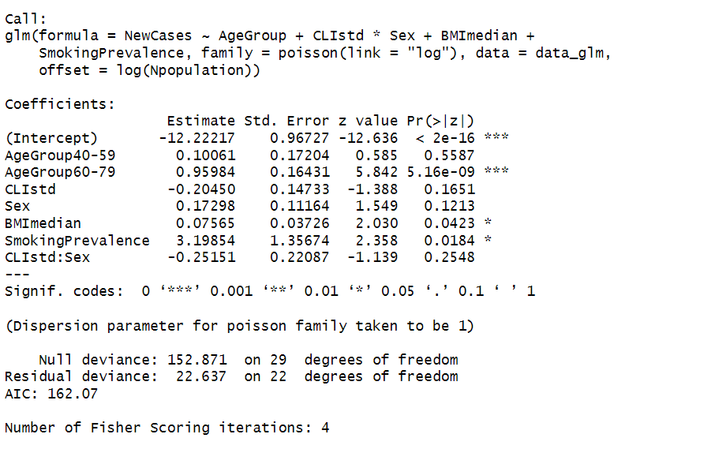
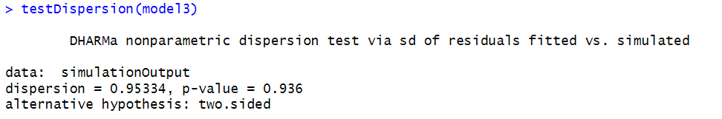
Model 3
In Model 3, AgeGroup, BMI and SmokingPrevalence were significant (p < 0.05), while, sex, CLIstd, and the interaction term were not significant.
The residuals seem normally distributed but we get some quantile deviation indicating a worse fit.

Slide 13
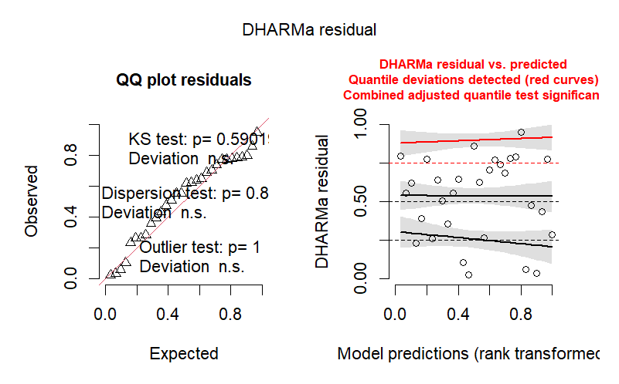
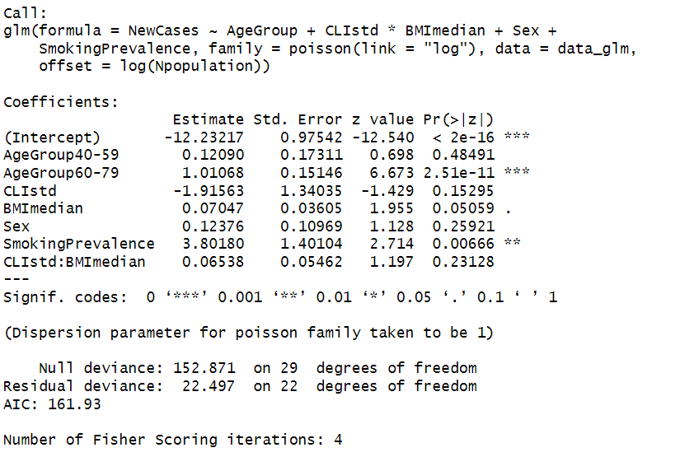
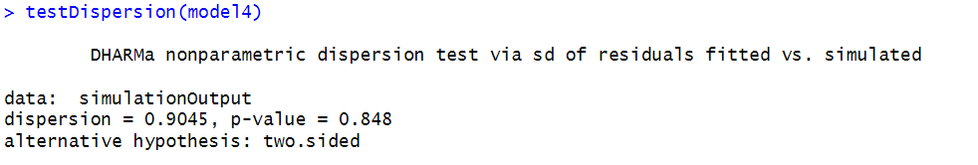
Model 4
In Model 4, AgeGroup and SmokingPrevalence were significant (p < 0.05), while sex, BMI, region, CLIstd, and the interaction term were not significant.
There is no overdispersion, but the residuals seem less normally distributed and we get some quantile deviation indicating a worse fit.

Slide 14
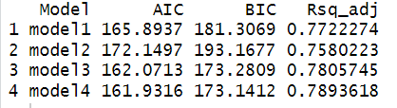
Matrix of model paramters
AIC evaluates how well your model fits the data while penalizing complexity (the number of parameters).
BIC - Similar to AIC but penalizes complexity more strongly,
R^2 - The proportion of variation in the response variable that your model explains.
We see good Model 3 and Model 4 have the best performance.

Slide 15
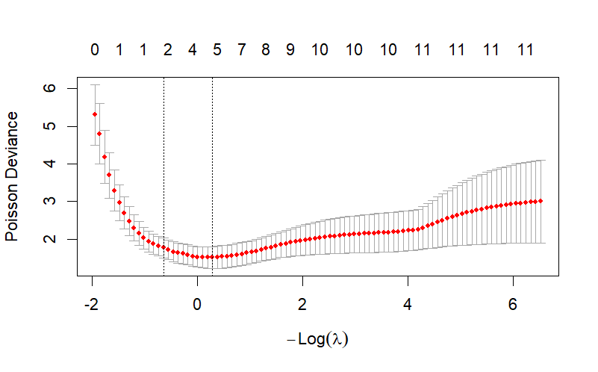
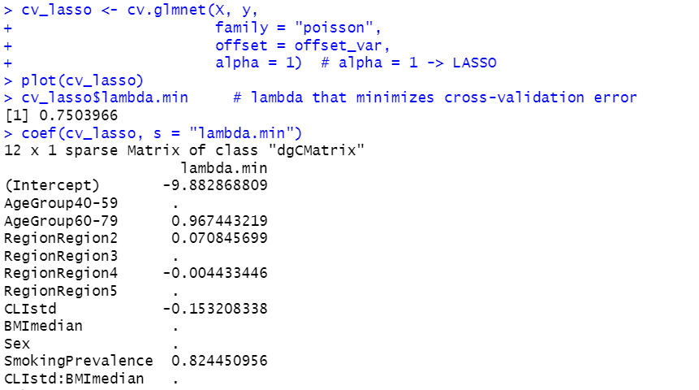
Lasso
We applied LASSO regularization to identify the most relevant predictors and reduce potential multicollinearity between correlated variables
LASSO selected AgeGroup and CLIstd as main predictors, supporting previous GLM findings

Slide 16
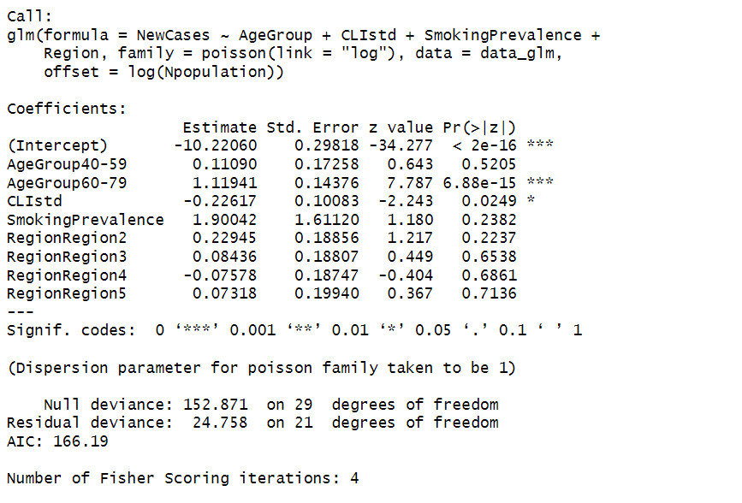
Lasso
In the LASSO model, the interaction term (CLIstd:BMImedian) was penalized to zero,
However, in model 4, including this interaction improved model fit
This difference arises because LASSO prioritizes model simplicity and generalization, whereas standard regression prioritizes in-sample explanatory power.

Slide 17
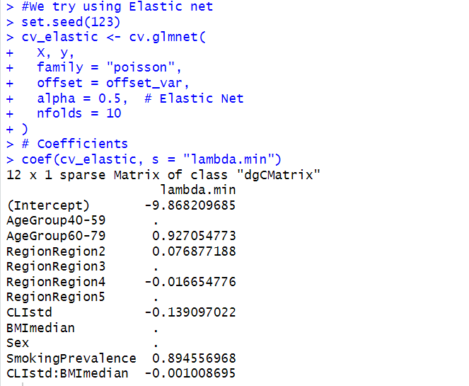
Elastic net
If we try an elastic net we can see that the model actually keeps the interaction term, however it is practically zero.

Slide 18
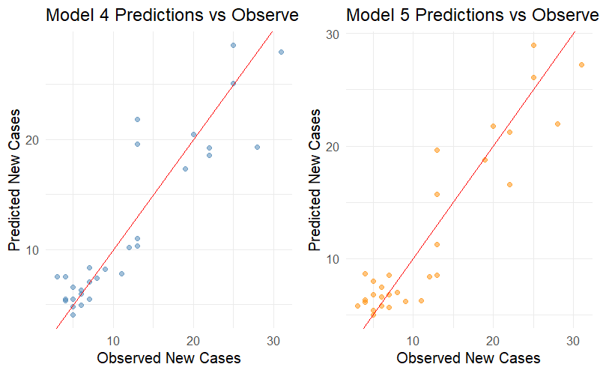
Prediction
Finally we use the two best models (4 and 5) to see how well they can predict new cases in pancreatic cancer.

Slide 19
SUmmary
Overall, this analysis highlights the strong influence of age and lifestyle on pancreatic cancer incidence and suggests that promoting healthier lifestyles could have a measurable impact on reducing cancer risk.
However, given the cross-sectional design, causality cannot be established, and future research should extend these findings using longitudinal data and additional behavioral or genetic covariates.

